Slide 1

Seshadri Rao Gudlavalleru Engineering College Department of CSE (Artificial Intelligence & Machine Learning)
Emotion Recognition Using Multimodal Deep Learning with Vision Transformers and Graph-Based Pose Analysis
By
Betha Hari Srimukhi (22481A4215)
Addada Nithya Phani Sri (22481A4201)
Gutta Alekhya (22481A4235)
Under the guidance of
Mrs. G. Kalyani
Assistant Professor
Department of CSE (Artificial Intelligence & Machine Learning)

Slide 2
Content
Abstract
Introduction
Objectives
Existing System
Proposed System
Implementation
Results

Slide 3
Abstract
Human emotion recognition is the process of identifying a person’s emotional state using multiple modalities such as facial expressions and body posture. Traditional systems mainly rely on facial features using CNN-based models, which often perform poorly in real-world conditions due to occlusion, lighting variations, and changes in posture. To overcome these limitations, this project proposes a multimodal emotion recognition system that combines Vision Transformer (ViT) for extracting global facial features and Pose Graph Convolutional Network (PGCN) for modeling posture-based information. These features are integrated using a hierarchical cross-attention fusion mechanism to generate a comprehensive emotional representation. The model is evaluated on the RAF-DB dataset, demonstrating improved accuracy and robustness compared to conventional approaches, making it suitable for real-world applications.

Slide 4
Introduction
Emotion recognition systems face several challenges:
Variations due to occlusion, lighting, and head movements
Limited accuracy when using only facial features
Difficulty in capturing emotions in real-world conditions
It is widely used in healthcare, surveillance, and human-computer interaction.
This project addresses these challenges by:
Using Vision Transformer (ViT) for facial features
Using Pose Graph CNN (PGCN) for posture analysis
Combining both using cross-attention fusion
Importance: Improves accuracy and reliability by using multimodal learning

Slide 5
Objectives
To develop a multimodal emotion recognition system .
To extract facial features using Vision Transformer (ViT)
To analyze posture using Pose Graph CNN (PGCN)
To integrate features using cross-attention fusion
To improve accuracy under real-world conditions

Slide 6
Existing System
Paper Title: "Multi-Modal CNN Features Fusion for Emotion Recognition: A Modified Xception Model"
Objective:
Develop emotion recognition using multimodal deep learning.
Combine facial (masked) and voice expressions
Use Modified Xception CNN for feature extraction
Apply fusion techniques (data, feature, decision level)
Improve performance over unimodal methods
Findings:
Multimodal approach improves accuracy compared to single modality
Feature-level fusion achieved highest accuracy (79.81%)

Slide 7
Limitations of Existing System
Limited performance when facial features are partially hidden or unclear (mask conditions).
CNN-based models mainly capture local features, lacking global context understanding.
Fusion techniques are not fully adaptive, leading to less effective feature integration.
Relies on audio modality, which may be noisy or unavailable in real-world scenarios.
Difficulty in handling complex real-world variations like pose and illumination.

Slide 8
Proposed System
Multimodal Emotion Recognition: Utilizes Vision Transformer (ViT) for extracting global facial features and Pose Graph Convolutional Network (PGCN) for capturing posture-based emotional cues.
Advanced Feature Fusion: Applies Hierarchical Cross-Attention mechanism to effectively combine facial and pose features for better representation.
Use of Real-World Dataset: Employs RAF-DB dataset containing diverse facial expressions with variations in lighting, pose, and occlusion.
Improved Accuracy & Robustness: Multimodal learning enhances emotion recognition performance, especially under challenging real-world conditions.

Slide 9
Methodology
Data Collection & Preprocessing: Use RAF-DB dataset, perform face detection, cropping, and resizing, and extract pose keypoints using MediaPipe.
Feature Extraction: Apply Vision Transformer (ViT) to extract global facial features and Pose Graph Convolutional Network (PGCN) to capture posture-based features.
Feature Representation: Convert pose keypoints into graph structure and generate meaningful feature embeddings from both modalities.
Multimodal Feature Fusion: Use Hierarchical Cross-Attention mechanism to combine facial and pose features into a unified representation.
Classification & Prediction: Apply dense layers with Softmax to classify emotions into predefined categories such as happy, sad, angry, etc.

Slide 10
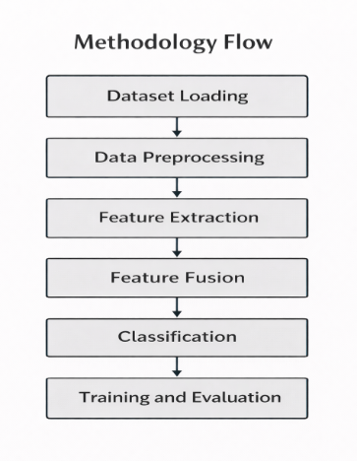

Slide 11
Implementation
Dataset Collection & Preparation: Downloaded RAF-DB dataset and organized it into training, validation, and test sets for model generalization.
Preprocessing & Keypoint Extraction: Performed face detection, resizing, and extracted pose keypoints using MediaPipe for posture analysis.
Feature Extraction Models: Used Vision Transformer (ViT) for extracting global facial features and Pose Graph Convolutional Network (PGCN) for learning posture-based representations.
Multimodal Feature Fusion: Applied hierarchical cross-attention to combine facial and pose features into a unified representation for emotion understanding.

Slide 12
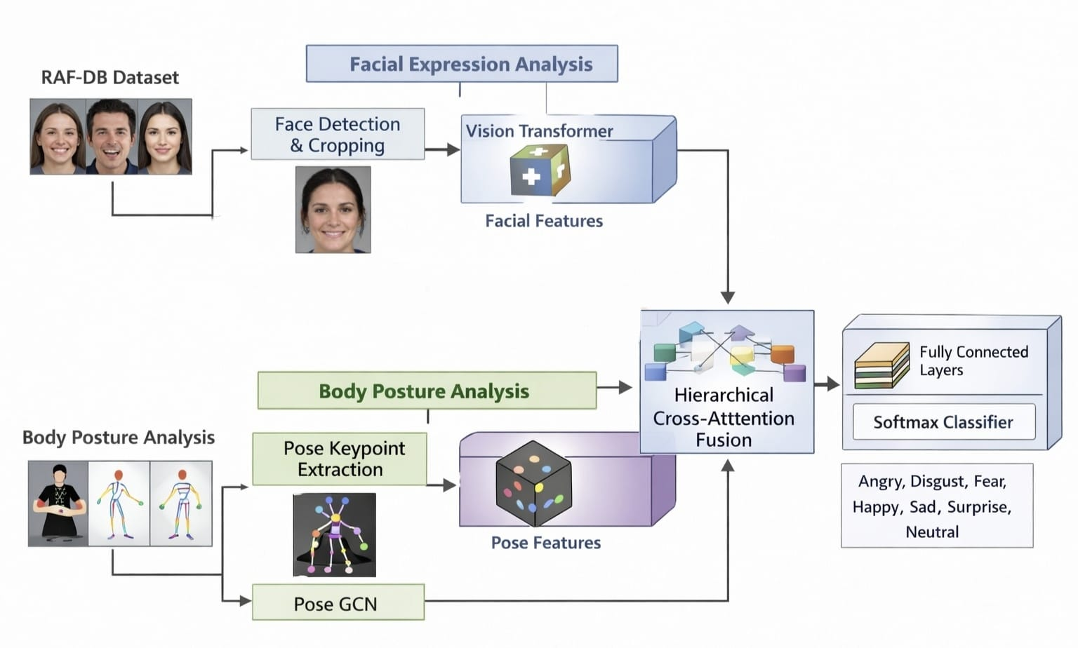
Experimental Results
Fig.: Architecture for multimodal emotion recognition using ViT,PGCN,HCA

Slide 13
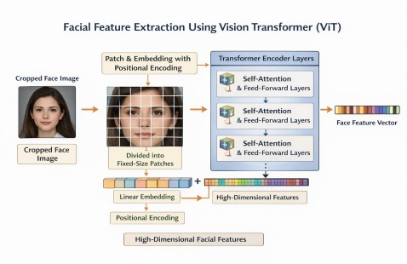
Experimental Results
Fig.: Facial Feature Extraction Using Vision Transformer (ViT)

Slide 14
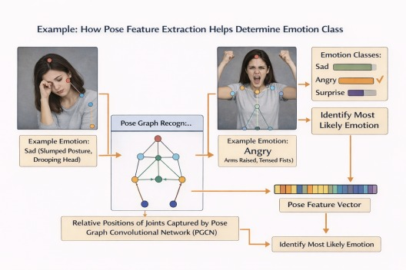
Experimental Results
Fig.: Illustration of posture-based emotion cues captured using pose keypoints and graph convolution.

Slide 15
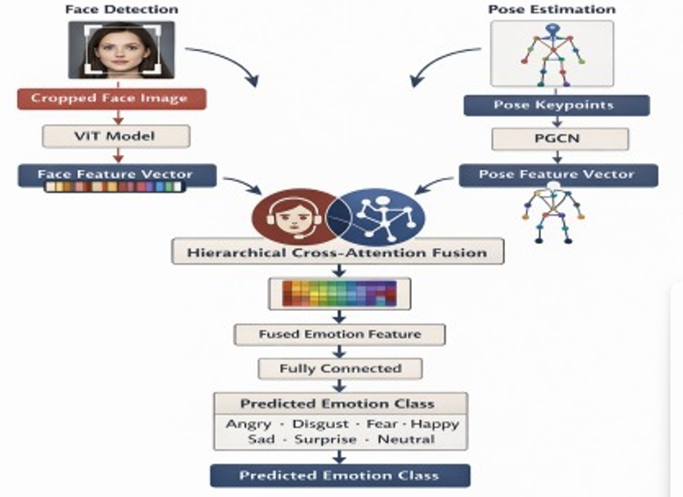
Experimental Results
Fig.: Features from face (ViT) and body pose (PGCN) are fused to combined to predict emotion class

Slide 16
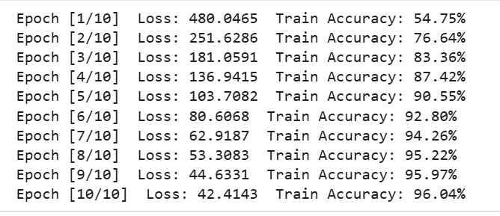
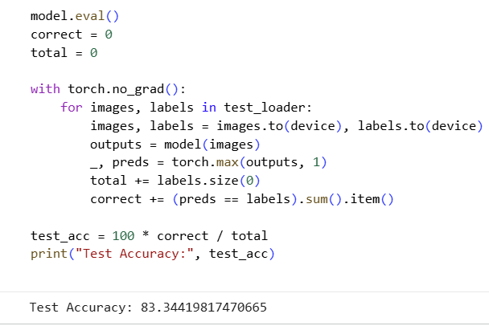
Experimental Results
Fig.: Training Accuracy.
Fig.: Test Accuracy

Slide 17
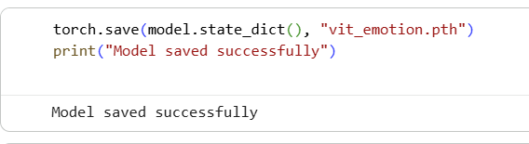
Experimental Results
Fig.: Finally, the trained model is saved

Slide 18

Custom Environment

Slide 19
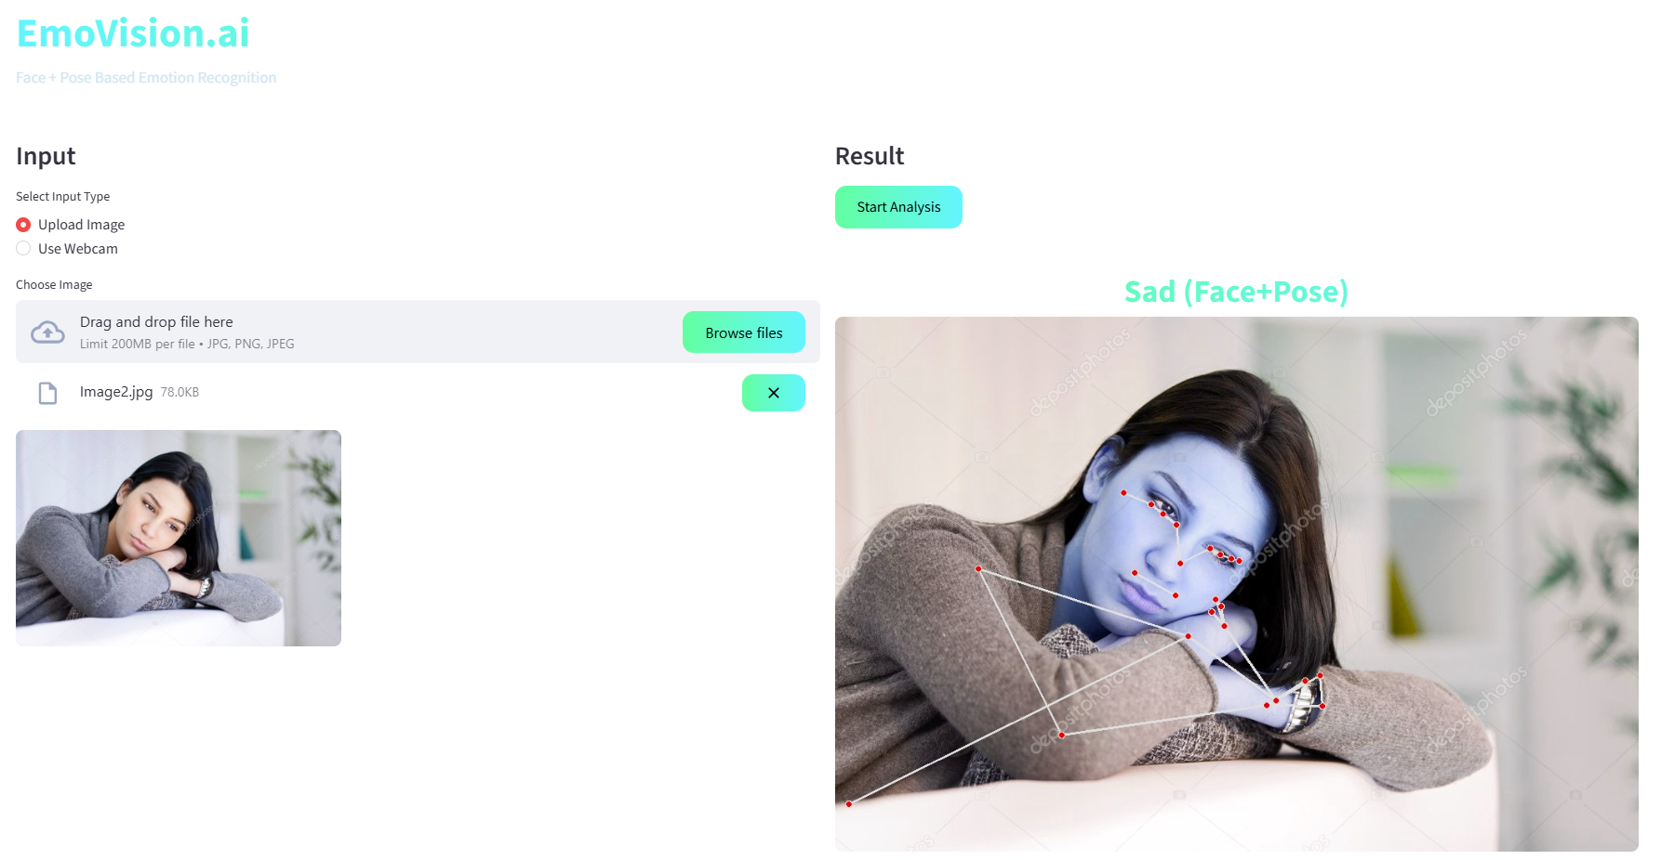
Experimental Results

Slide 20
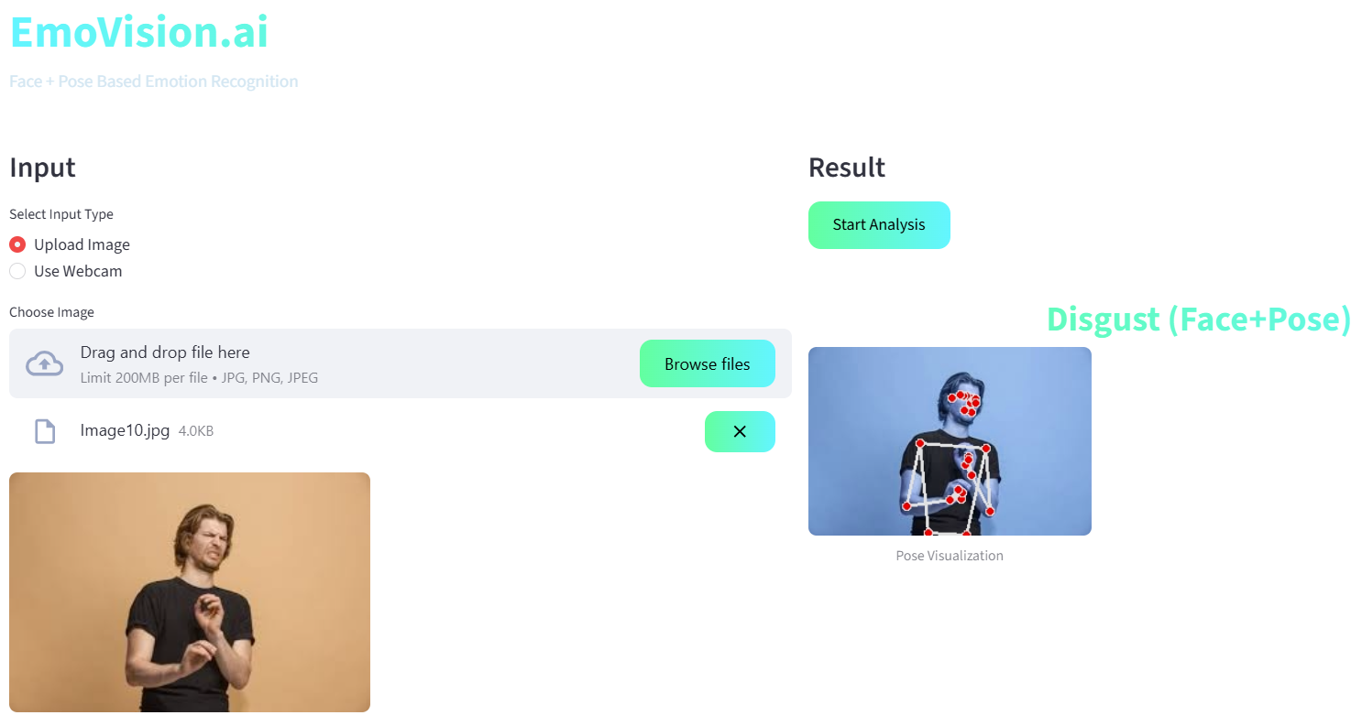
Experimental Results

Slide 21
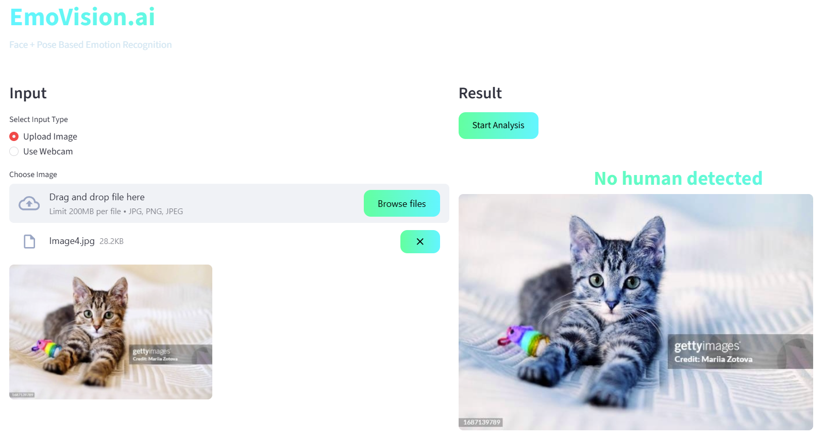
Experimental Results

Slide 22


